Slide 1


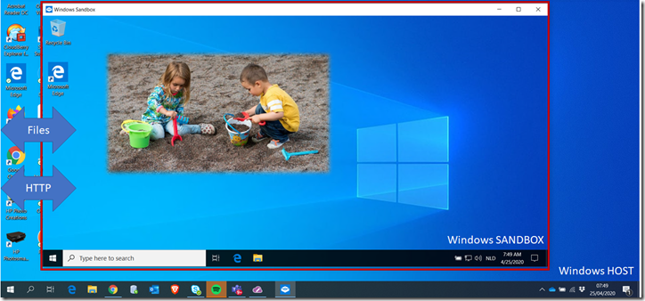

Code Café Online DBeaver DirectPoll Devoxx Windows Sandbox
Code Café Online- 4 May 2020
Henk Jan van Wijk & Lucas Jellema

Slide 2

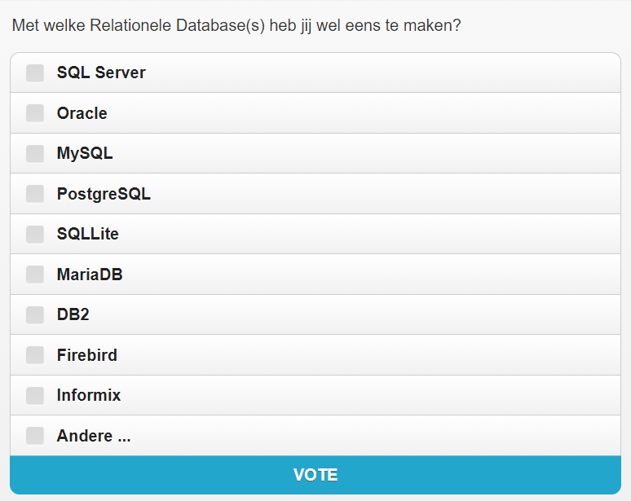
DirectPoll
http://etc.ch/Ztuv

Slide 3
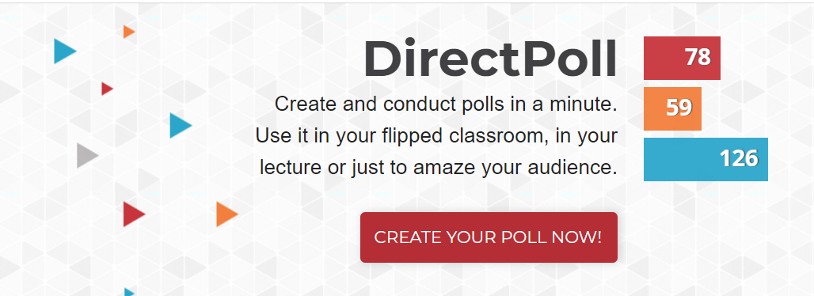
DirectPoll
https://directpoll.com/

Slide 4
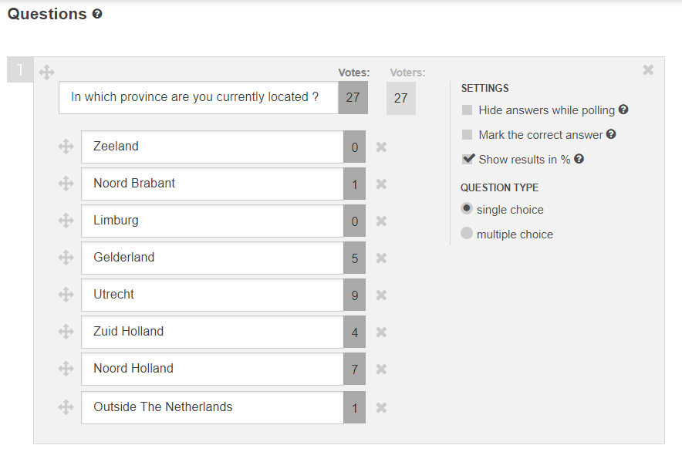
DirectPoll
Multiple Choice questions
single or multiple response
answers can marked as correct
Live result gathering
Presented as horizontal bar charts
Results are retained for analysis at a later moment
Polls can be reused
Maximum 500 concurrent voters
Free

Slide 5

Devoxx
Notes:
https://www.youtube.com/watch?v=J6fegDQPgps&list=PLRsbF2sD7JVqPgMvdC-bARnJ9bALLIM3Q

Slide 6
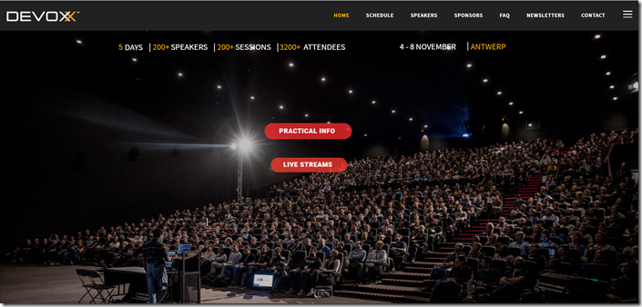

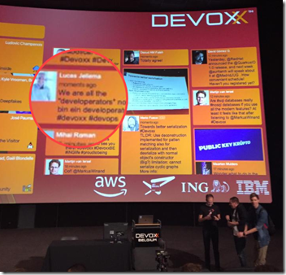
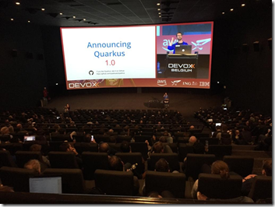
Devoxx Belgium 2019
Notes:
https://technology.amis.nl/2019/11/11/the-state-of-java-developers-reflections-on-devoxx-2019/

Slide 7
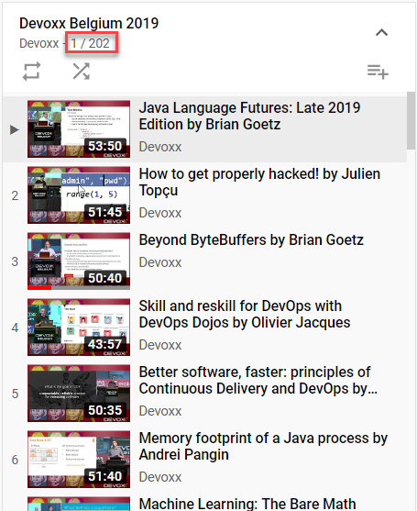
Devoxx Belgium 2019
Full Playlist on YouTube
https://www.youtube.com/watch?v=J6fegDQPgps&list=PLRsbF2sD7JVqPgMvdC-bARnJ9bALLIM3Q
Notes:
https://www.youtube.com/watch?v=J6fegDQPgps&list=PLRsbF2sD7JVqPgMvdC-bARnJ9bALLIM3Q

Slide 8
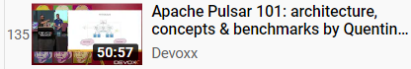
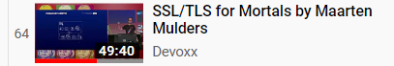
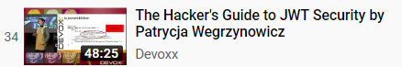
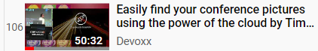
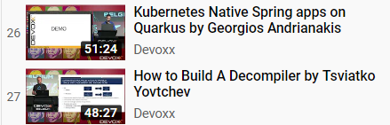
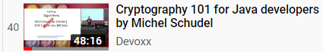
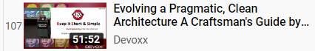
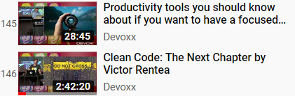
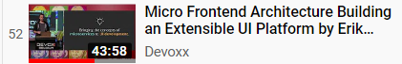
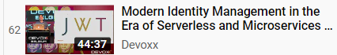
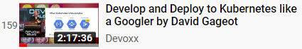
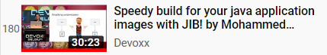
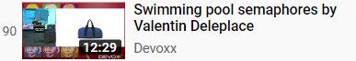
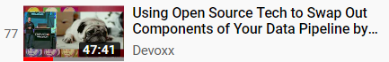
Devoxx Belgium 2019 What to Watch?

Slide 9
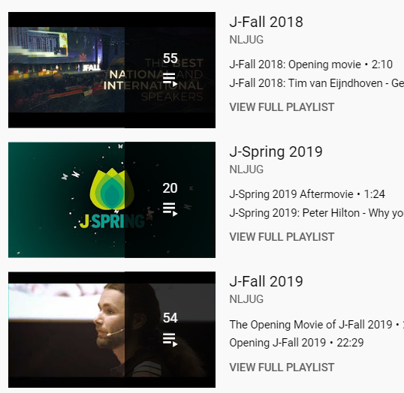
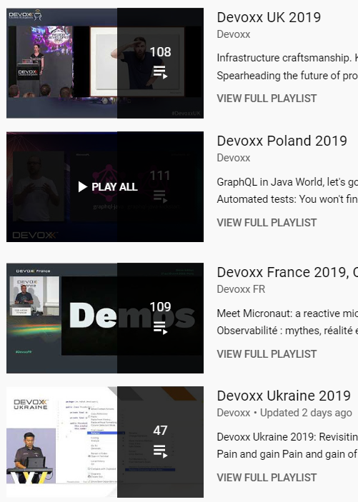
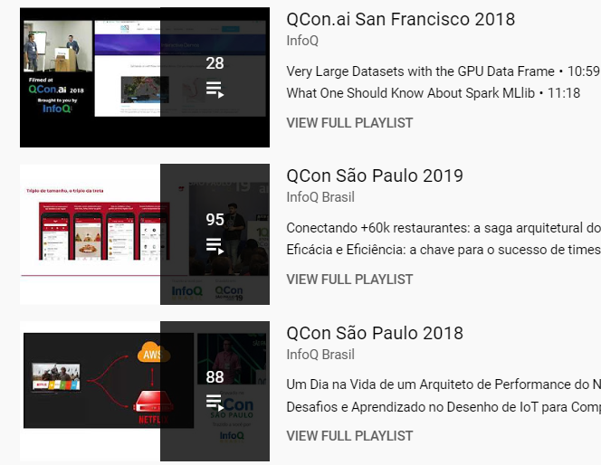

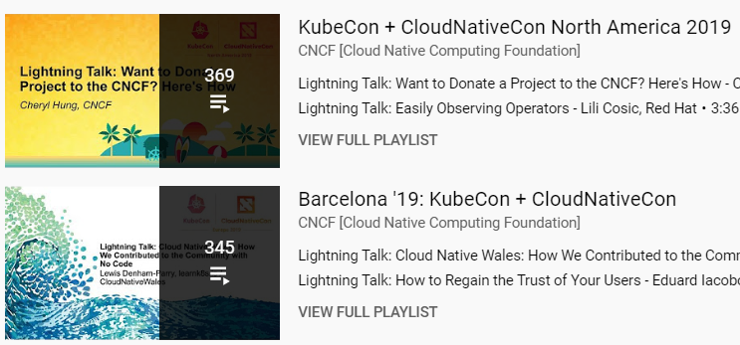
Wait…. There is more…

Slide 10
Windows Sandbox
Part of Windows 10 – 1903 and later (installed on my laptop in mid April 2020)

Slide 11
Windows Sandbox is a new lightweight desktop environment tailored for safely running applications in isolation.
Part of Windows – everything required for this feature ships with Windows 10 Pro and Enterprise. No need to download a VHD!
Pristine – every time Windows Sandbox runs, it’s as clean as a brand-new installation of Windows
Disposable – nothing persists on the device; everything is discarded after you close the application
Secure – uses hardware-based virtualization for kernel isolation, which relies on the Microsoft’s hypervisor to run a separate kernel which isolates Windows Sandbox from the host
Efficient – uses integrated kernel scheduler, smart memory management, and virtual GPU

Slide 12
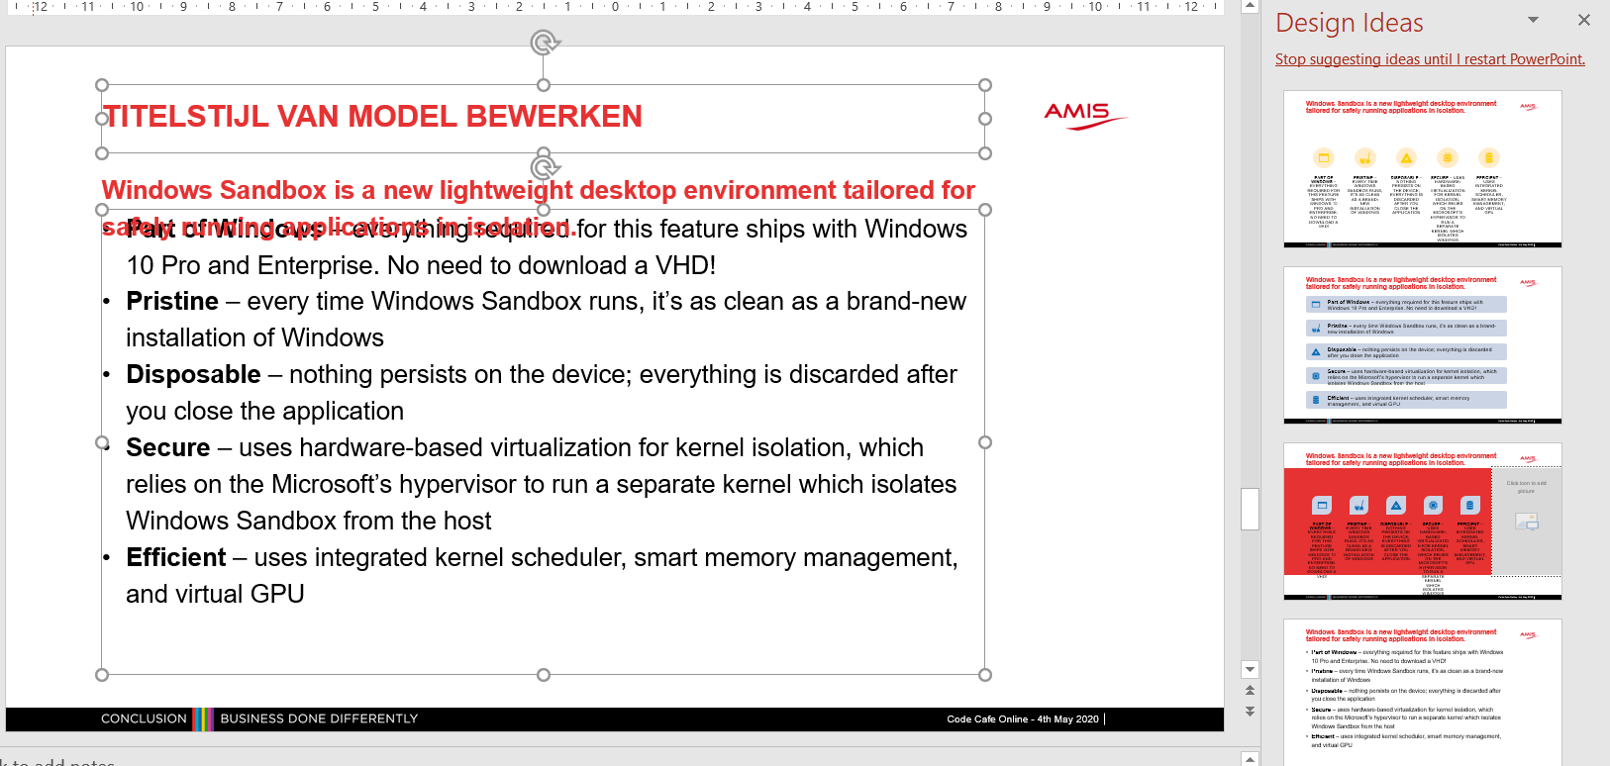
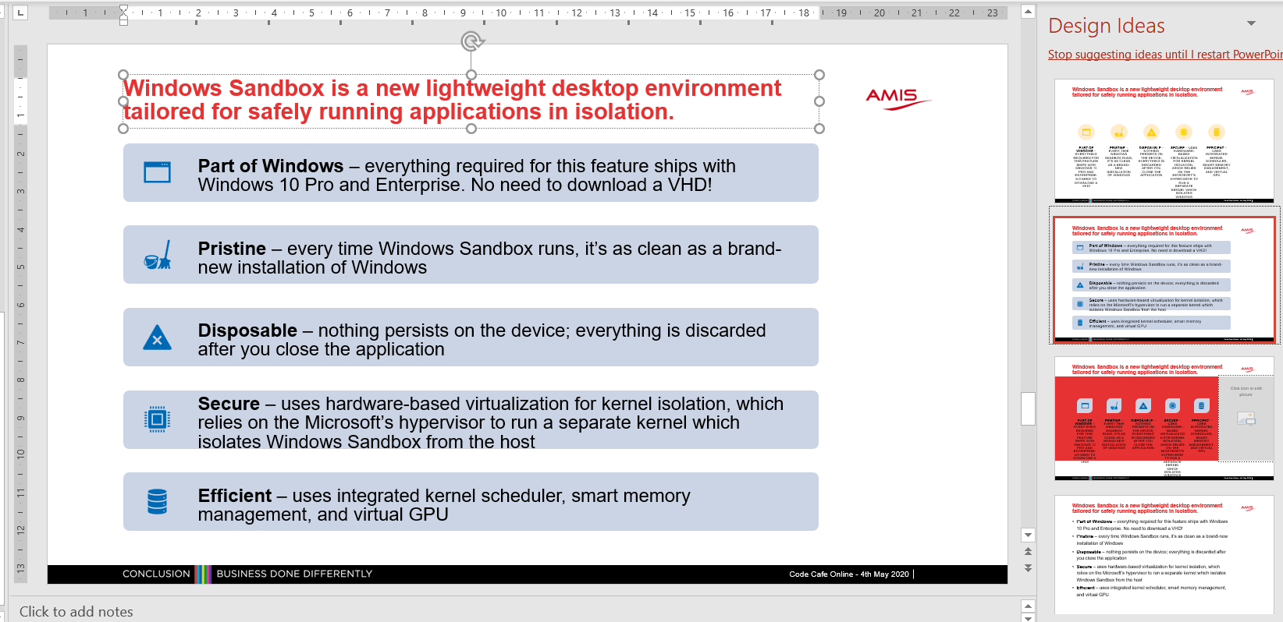
Intermezzo: Powerpoint Design Ideas

Slide 13
Windows Sandbox is a new lightweight desktop environment tailored for safely running applications in isolation.
Part of Windows – everything required for this feature ships with Windows 10 Pro and Enterprise. No need to download a VHD!
Pristine – every time Windows Sandbox runs, it’s as clean as a brand-new installation of Windows
Disposable – nothing persists on the device; everything is discarded after you close the application
Secure – uses hardware-based virtualization for kernel isolation, which relies on the Microsoft’s hypervisor to run a separate kernel which isolates Windows Sandbox from the host
Efficient – uses integrated kernel scheduler, smart memory management, and virtual GPU

Slide 14
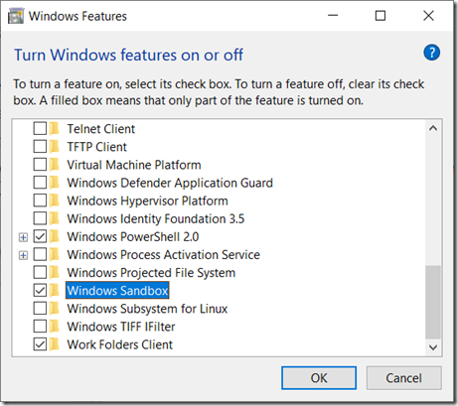
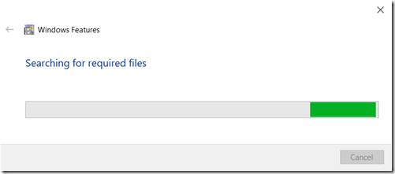
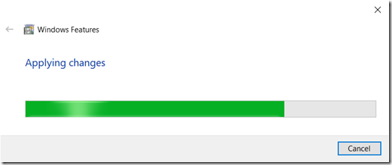
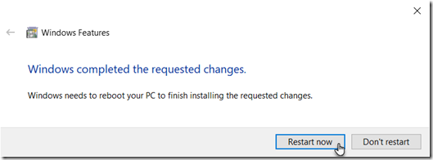
How to get going
You need Windows 1903 (build 18305) or later
Turn Windows Sandbox feature on

Slide 15
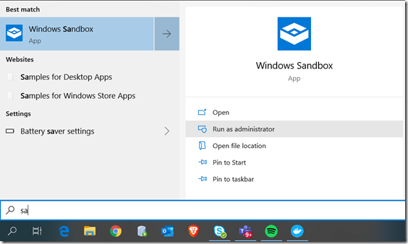
How to get going (2)
After the reboot:
Warning: Windows Sandbox and VirtualBox do not play together
After running the Sandbox, you need to “undo” Windows virtualization in order to run VirtualBox again

Slide 16
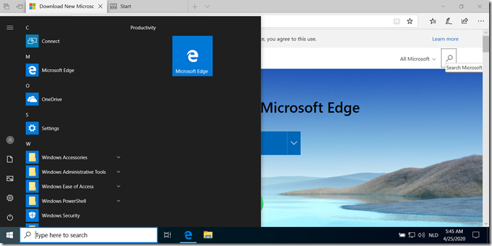
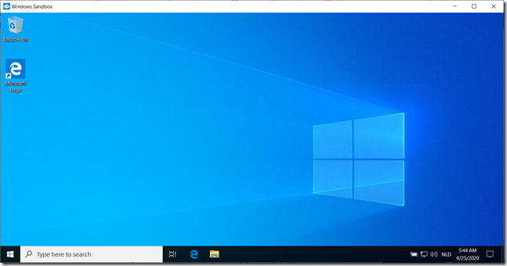
Inside the Sandbox

Slide 17
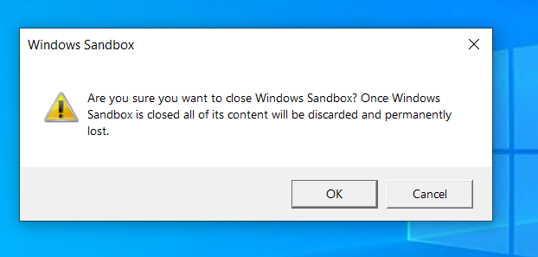
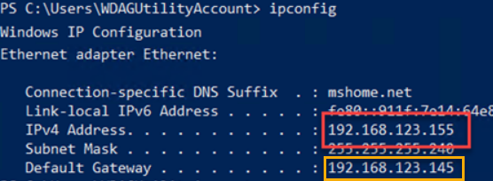
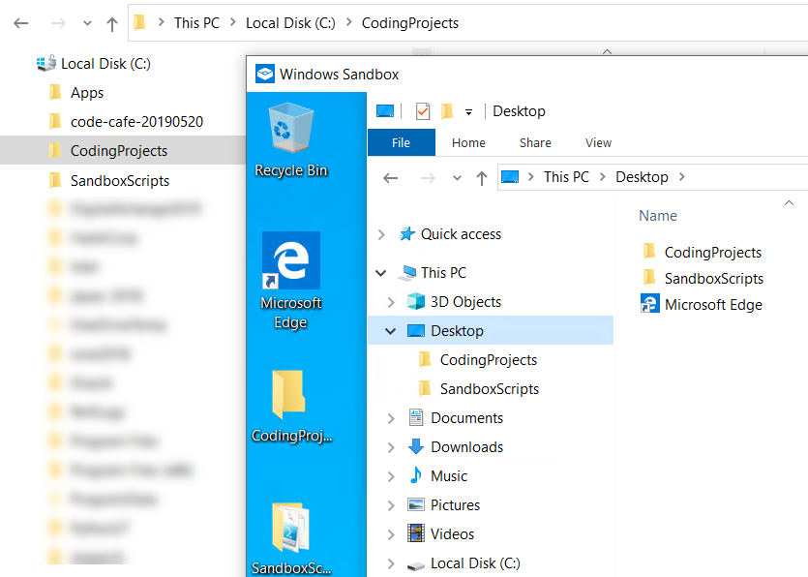
What else is there to know?
When you stop the Sandbox, its contents is destroyed
The Sandbox has its own IP address
Can interact over network with Host (and vice versa)
Can interact with the rest of the world
Folders on host can be shared with Sandbox
Mapped to a fixed path inside the Sandbox C:\users\wdagutilityaccount\desktop\
Notes:
https://techcommunity.microsoft.com/t5/windows-kernel-internals/windows-sandbox/ba-p/301849
https://docs.microsoft.com/en-us/windows/security/threat-protection/windows-sandbox/windows-sandbox-configure-using-wsb-file

Slide 18
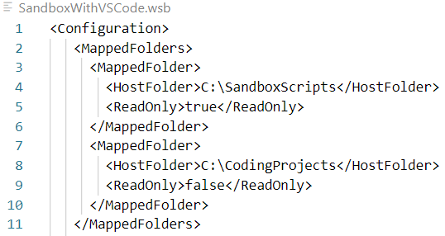
Folder Mapping from Host to Sandbox
HOST

Slide 19
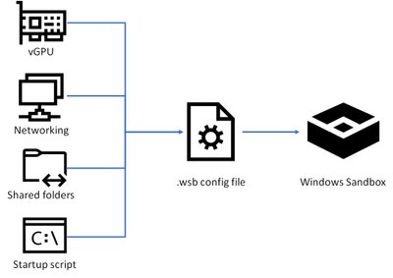
What else is there to know?
Sandbox can be started from a specific wsb configuration file, that defines
Shared Folders
A single (Powershell, CMD) Startup Script
vGPU, Memory
(what) Networking (is allowed)
Audio/Video/ClipBoard/ProtectedClient
Notes:
https://techcommunity.microsoft.com/t5/windows-kernel-internals/windows-sandbox/ba-p/301849
https://docs.microsoft.com/en-us/windows/security/threat-protection/windows-sandbox/windows-sandbox-configure-using-wsb-file

Slide 20
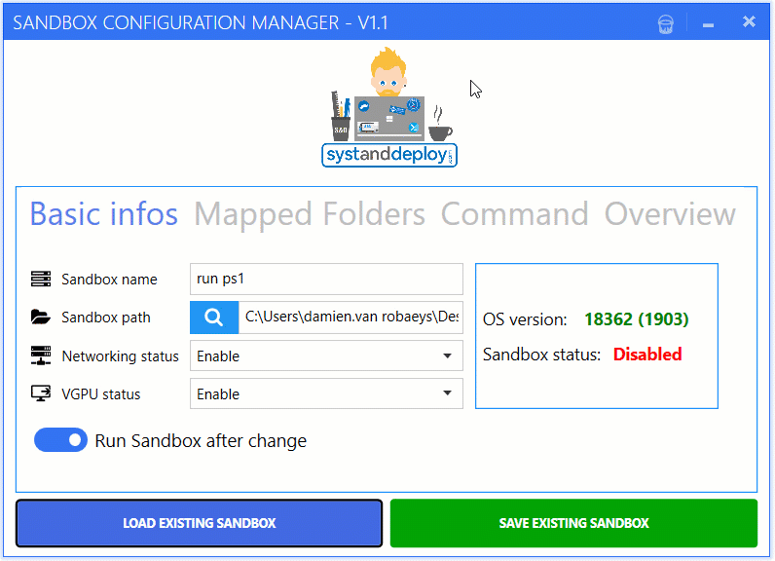
Windows Sandbox Editor
https://gallery.technet.microsoft.com/Windows-Sandbox-Configurati-f2c863dc

Slide 21
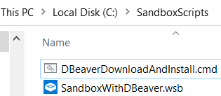
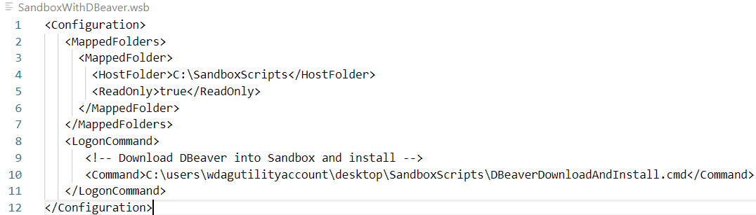
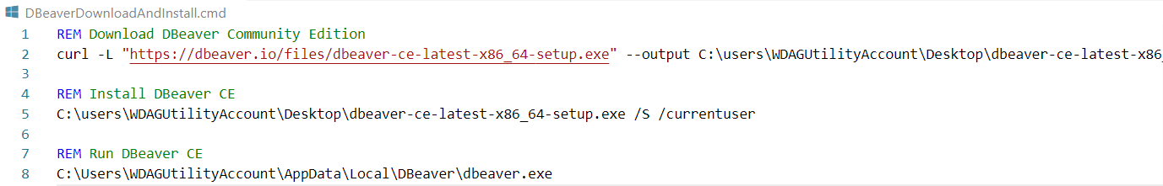
Run Windows Sandbox with DBeaver

Slide 22
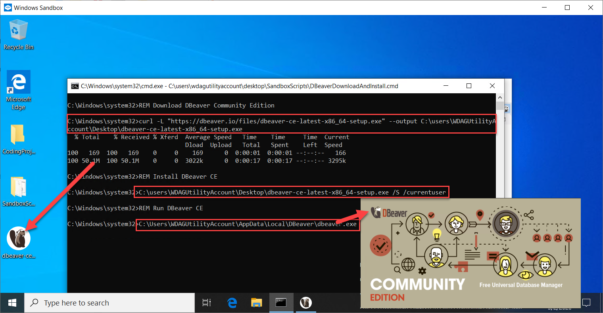
Run Windows Sandbox with DBeaver

Slide 23
Thank you for your attention We hope this was useful
Code Café Online- 4 May 2020
Henk Jan van Wijk & Lucas Jellema

Slide 24

ISDb: International Session|Seminar Database
S
Find Video Recordings of Conference Sessions, Webinars, Online Meetups, Tutorials
Links to Download or Stream recording
Details about the speaker(s), session topics and content
Associated resources (demo scripts, articles, URLs, podcast, …)
Reviews
Suggestions for other session recordings
Favorites and Share

Slide 25







Title, Abstract, Tags & Topics
Language, Date, Duration,Level, Code?, Demo?
URL for Stream or Download
Name, Bio, Photograph, Publications, Social Media contact details
Speaker
Name, Location & Venue, Dates, Organization, Website, Social Media, calendar
Resource
Session
Event
Slides, Code, Article, Book, related sessions, Photographs
Review
Reviewer
Tags & Topics, Notes, Favorite?
Score: content, technical recording quality, speaking style
Name, Bio, Photograph, Publications, Social Media contact details

